Slide 1
BRAIN BITE
DEVELOPED BY:
GAGANDEEP SINGH(1315248)
KARAN MAHAJAN()
AVNEET KAUR()
RAJVEER KAUR()
PRIYA()

Slide 2
INTRODUCTION
Brain Bite is an online web based quiz application that was developed in JAVA language.User’s can play the quiz frequently and in very effective manner.The user can play different type of quizes like GK,Sports and Technical quiz.Each category has at least five or six questions.User can gain two marks for a correct answer and one mark is deducted from the user’s score for a wrong answer.Also the user details and his result is stored in the database.User cannot login the application without userid and password.

Slide 3
TOOLS:
FRONT END: JAVA LANGUAGE(SWING)
BACK END : ORACLE 10g

Slide 4
FRAMES
SNAPSHOTS

Slide 5
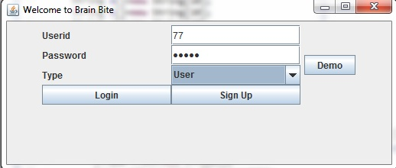
USER LOGIN

Slide 6
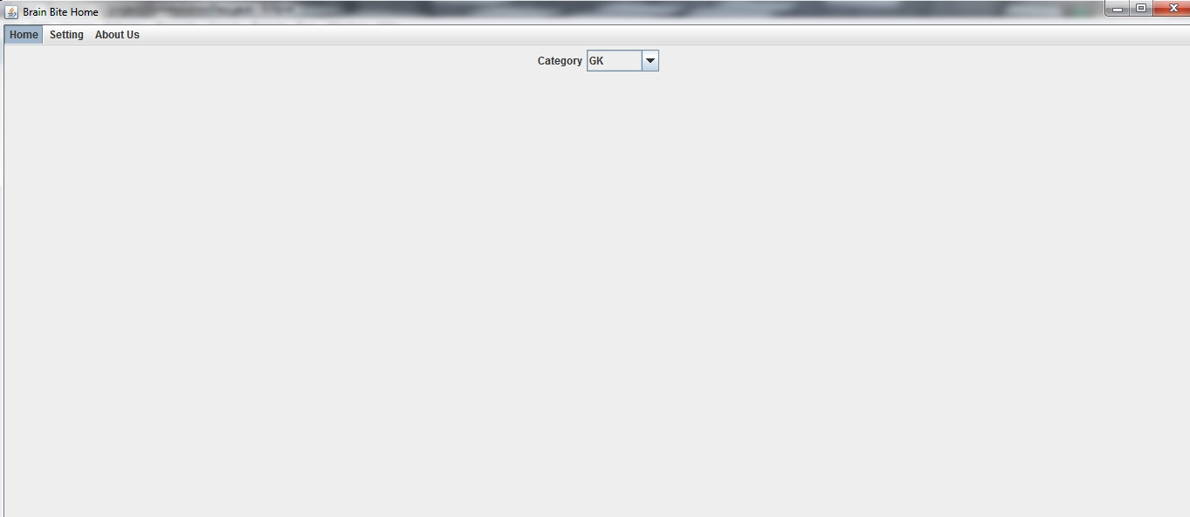
HOME MENU

Slide 7
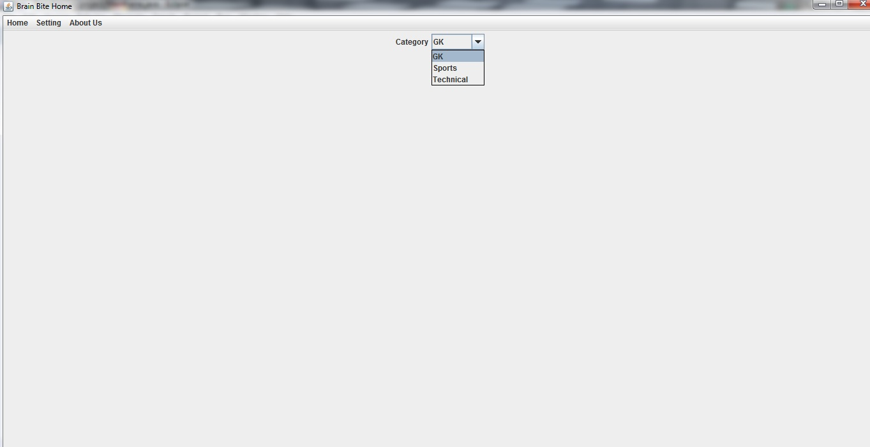
GK CATEGORY

Slide 8
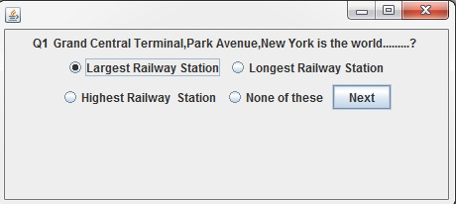
GK QUESTION-1

Slide 9
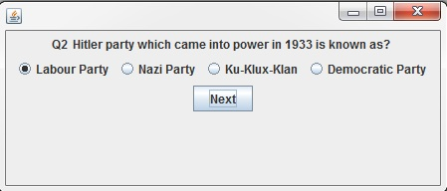
GK QUESTION-2

Slide 10
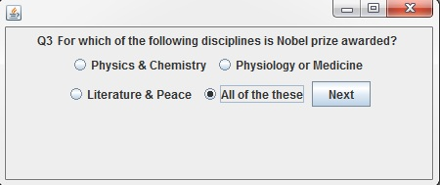
GK QUESTION-3

Slide 11
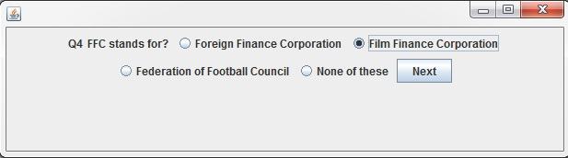
GK QUESTION-4

Slide 12
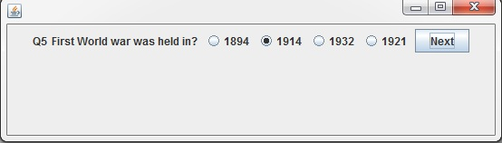
GK QUESTION-5

Slide 13
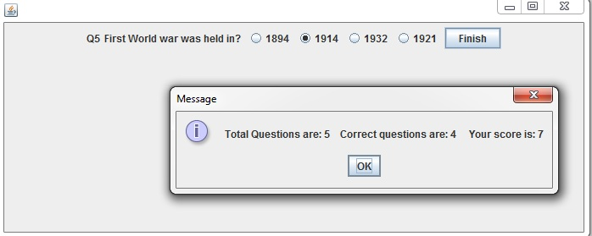
RESULT

Slide 14

SPORTS CATEGORY

Slide 15
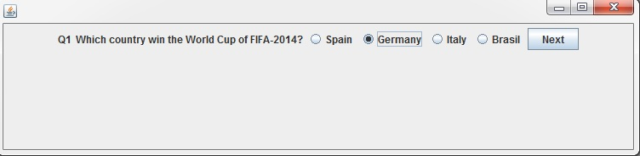
SPORTS QUESTION-1

Slide 16
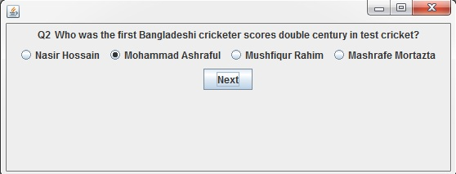
SPORTS QUESTION-2

Slide 17
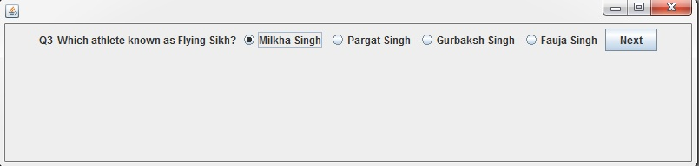
SPORTS QUESTION-3

Slide 18
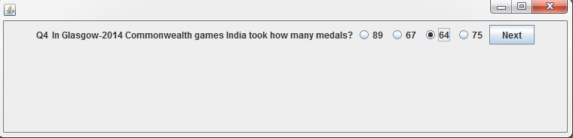
SPORTS QUESTION-4

Slide 19
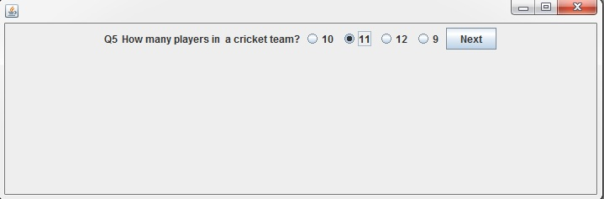
SPORTS QUESTION-5

Slide 20
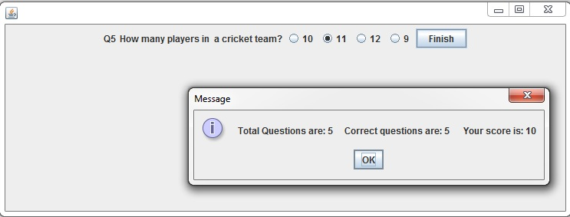
RESULT

Slide 21
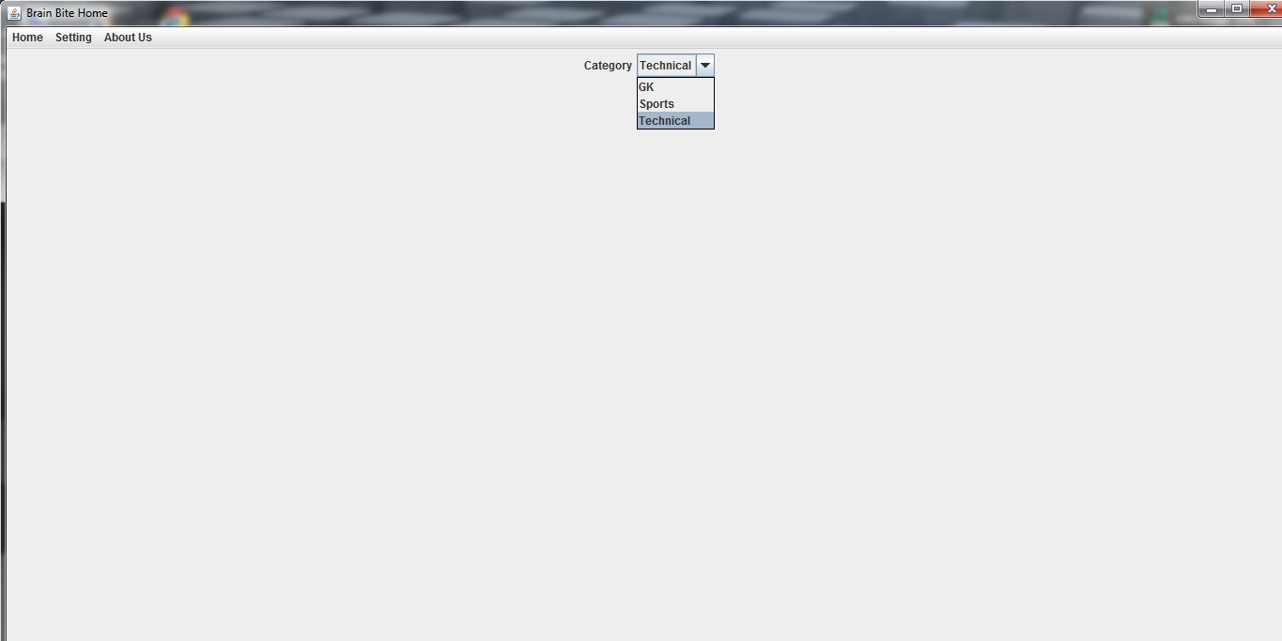
TECHNICAL CATEGORY

Slide 22
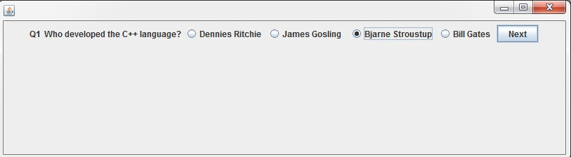
TECHNICAL QUESTION-1

Slide 23
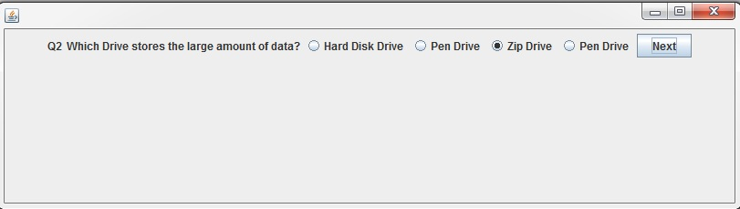
TECHNICAL QUESTION-2

Slide 24
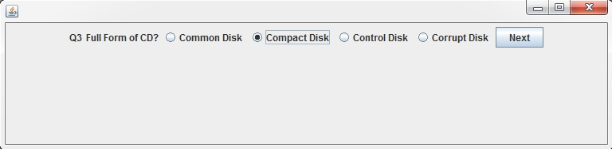
TECHNICAL QUESTION-3

Slide 25
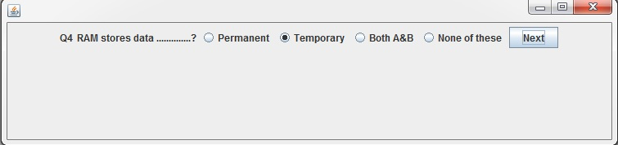
TECHNICAL QUESTION-4

Slide 26
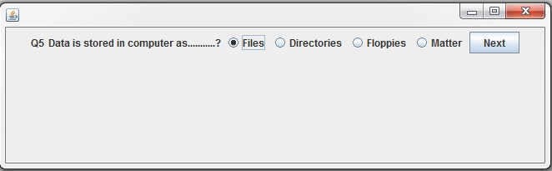
TECHNICAL QUESTION-5

Slide 27
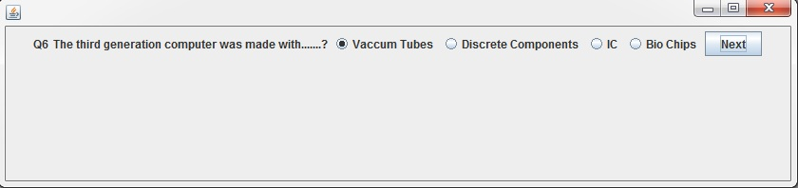
TECHNICAL QUESTION-6

Slide 28
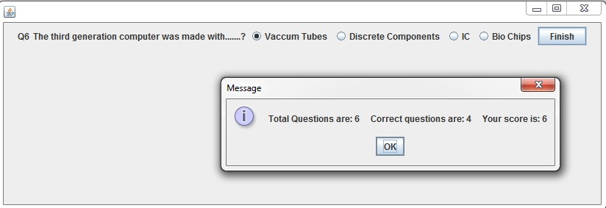
RESULT

Slide 29
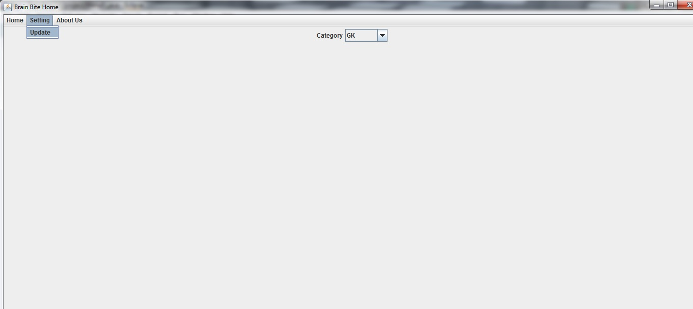
SETTING MENU

Slide 30
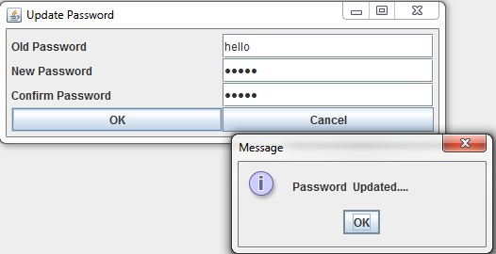
USER’S UPDATE PASSWORD

Slide 31
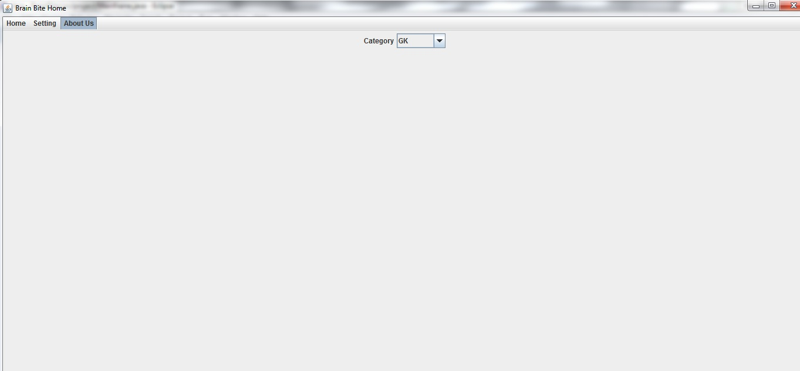
ABOUT US MENU

Slide 32
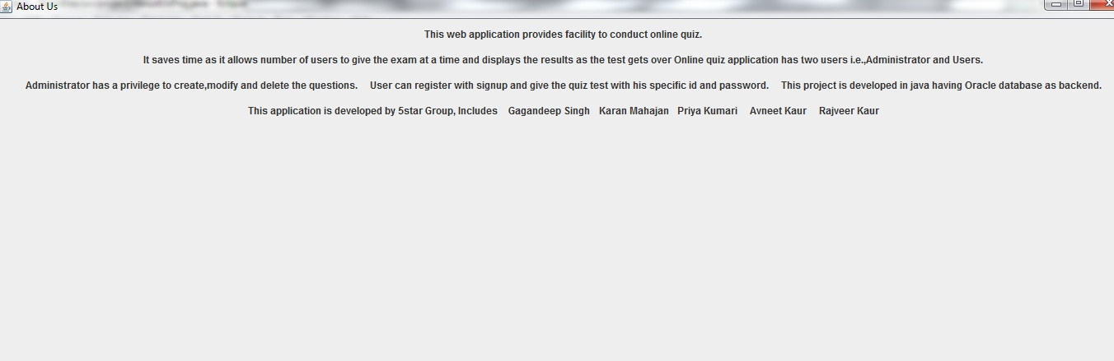
ABOUT US

Slide 33
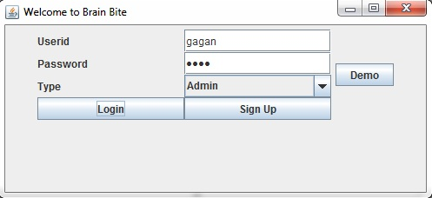
ADMIN LOGIN

Slide 34
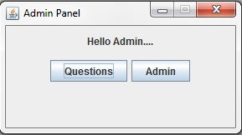
ADMIN PANEL

Slide 35
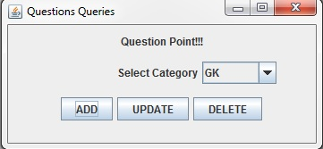
QUESTIONS QUERIES

Slide 36
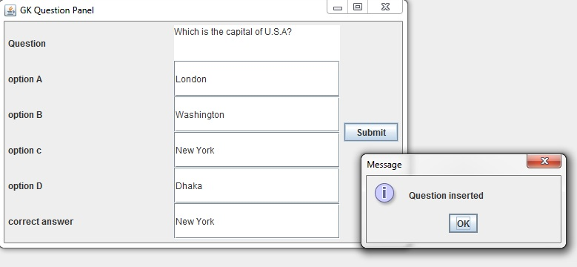
QUESTION INSERTED

Slide 37
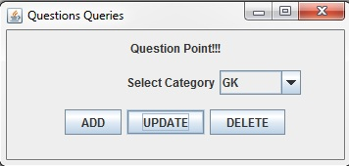
QUESTION QUERIES

Slide 38
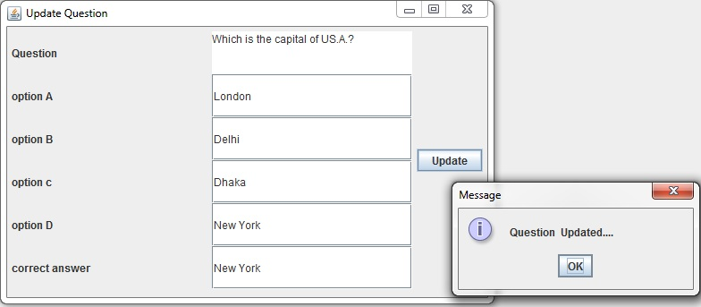
QUESTION UPDATED

Slide 39
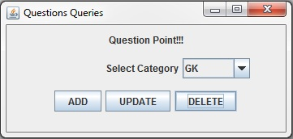
QUESTION QUERIES

Slide 40
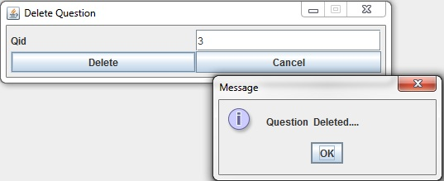
QUESTION DELETED

Slide 41
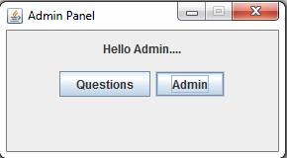
CLICK ON ADMIN BUTTON

Slide 42
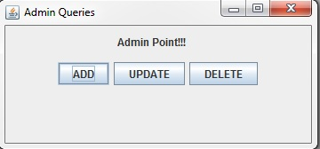
CLICK ON ADD BUTTON

Slide 43
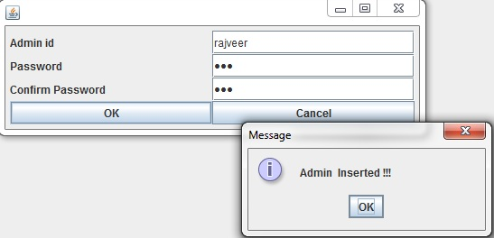
CREATE NEW ADMIN

Slide 44
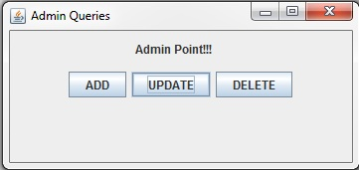
CLICK ON UPDATE BUTTON

Slide 45
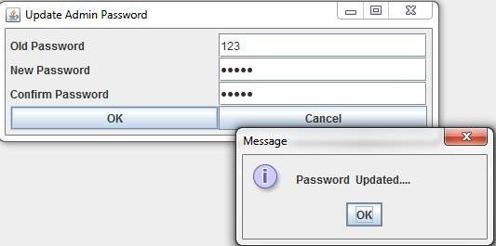
UPDATE PASSWORD

Slide 46
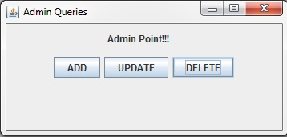
CLICK ON DELETE BUTTON

Slide 47
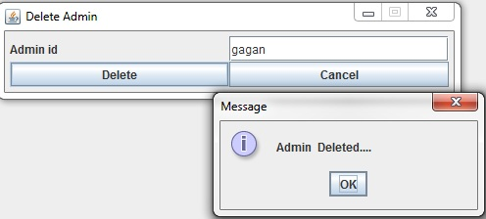
DELETE ADMIN

Slide 48
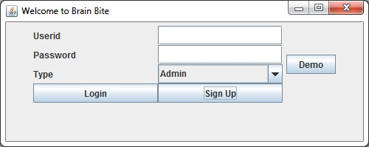
CLICK ON SIGN UP

Slide 49
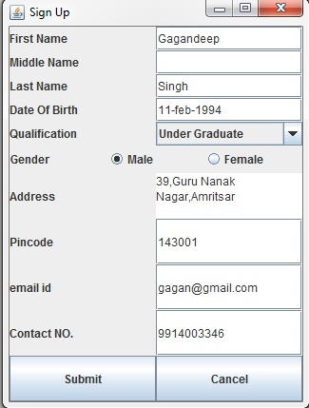
USER’S SIGN UP

Slide 50
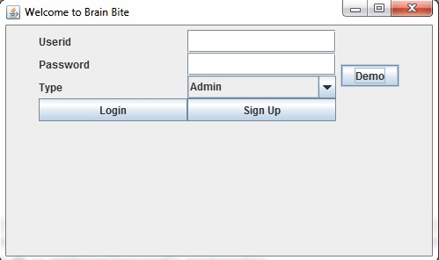
CLICK ON DEMO BUTTON

Slide 51
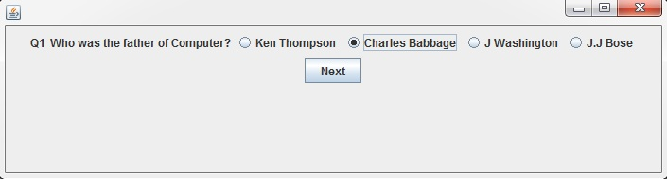
DEMO QUESTION-1

Slide 52
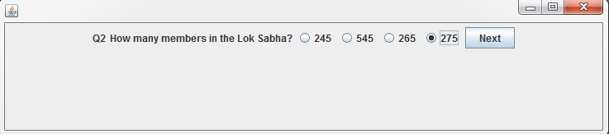
DEMO QUESTION-2

Slide 53
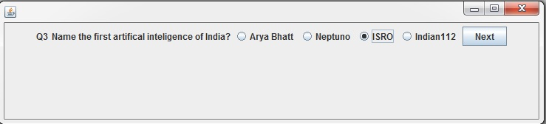
DEMO QUESTION-3

Slide 54
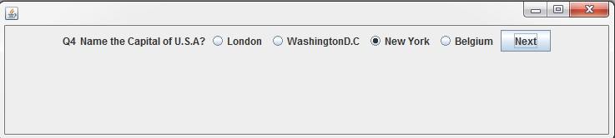
DEMO QUESTION-4

Slide 55
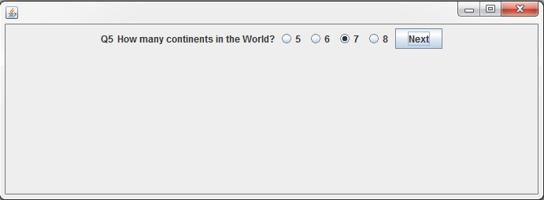
DEMO QUESTION-5

Slide 56

RESULT

Slide 57

INVALID USER

Slide 58

INVALID ADMIN

Slide 59
FUTURE SCOPE
This can be used in educational institutions as well as in corporate world.
Can be used anywhere any time as it is a web based application(user location doesn’t matter).
No restriction that examiner has to be present when the candidate gives the test.
User can check his knowledge.

Slide 60
ANY QUERY???

Slide 61
THANK YOU!!!

